Slide 1

Egoless Writing:
Improving Quality by Replacing Artistic Impulse with Engineering Discipline
By: Edmond H. Weiss, PH.D.
Presentation by: Russell Masters

Slide 2
Contents
About the Author
General Overview
The Problem
A Solution
Artist VS. Engineer
A Look Into the Future

Slide 3
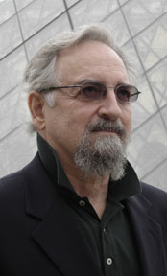
Brief Description
Publications
Impact
Involvement

Slide 4
General Overview
Basic Idea
    personal interest leads to poor design
Focus
    coding compared to writing manuals

Slide 5
The Problem
Attachment
Effects
    Defensiveness
    Little testing
    Not flexible

Slide 6
A Solution
Group Projects
PROS
CONS
Higher Modularity
Better Tested
Increased Reusability
Less Downtime
Late
Loss of Ego

Slide 7
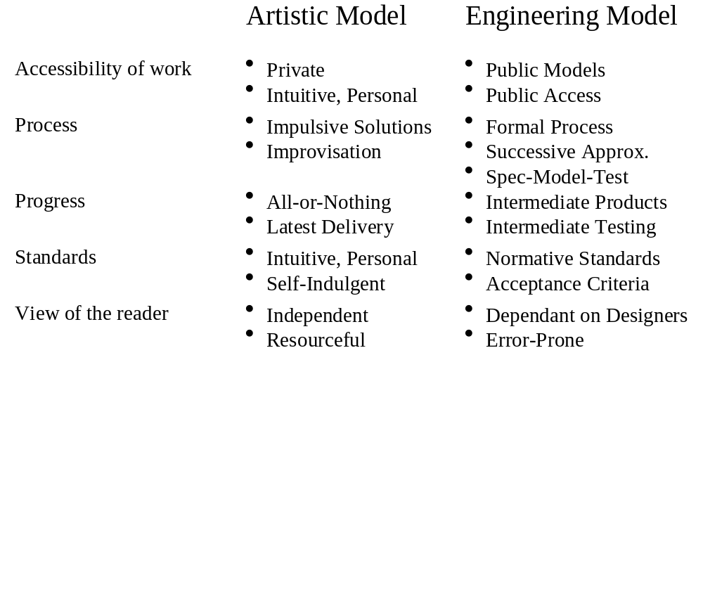
Artist VS. Engineer

Slide 8
A Look Into the Future
Conflict
    outlined code
Jobs
    Information Locators?

